Slide 1
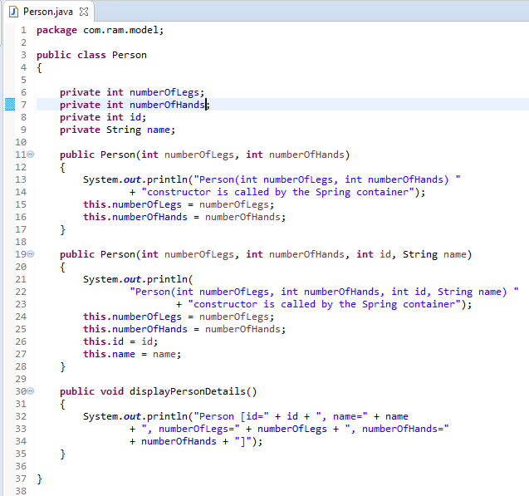
Inheriting Bean in Spring

Slide 2
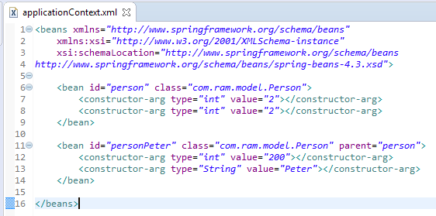
Inheriting Bean in Spring
By using the parent attribute of bean, we can specify the inheritance relation between the beans. In such case, parent bean values will be inherited to the current bean.

Slide 3
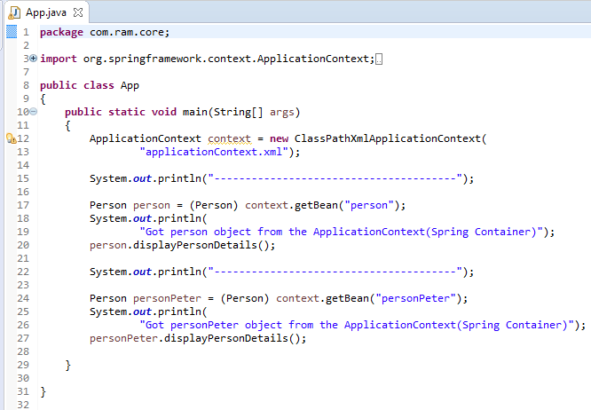
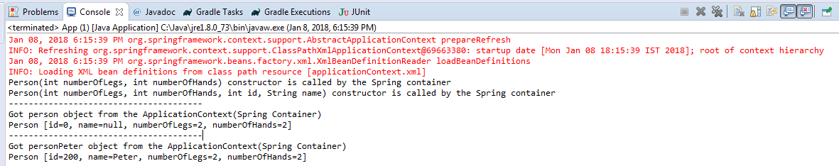
Inheriting Bean in Spring

